Slide 1
Role of Virtualization
Abhirup Khanna

Slide 2
Objectives
Introduction To Virtualization
Benefits of Virtualization
Types of Virtualization
Difference between Cloud and Virtualization

Slide 3
Introduction
Virtualization refers to the creation of a virtual resource such as a server, desktop, operating system, file, storage or network.
The main goal of virtualization is to manage workloads by radically transforming traditional computing to make it more scalable.

Slide 4
introduction
Builds an abstraction of the existing system.
A generic logic definition of the system is built into software.
Useful to replicate the behavior of the cloned system over multiple instances.
These multiple instances can then be made to run on the same hardware system it clones, and can share resources through a hypervisor that multiplexes the requests to the single system real hardware instance.

Slide 5
hypervisor
A hypervisor or virtual machine monitor (VMM) is computer software, firmware or hardware that creates and runs virtual machines.
A computer on which a hypervisor runs one or more virtual machines is called a host machine, and each virtual machine is called a guest machine.

Slide 6
Types of hypervisor
Type I is the bare-metal hypervisor that are deployed directly over the host's system hardware without any underlying operating systems or software.
Examples of the type I hypervisors:
  Microsoft Hyper-V hypervisor
  VMware ESXi
  Citrix XenServer

Slide 7
Types of hypervisor
Type two is a hosted hypervisor that runs as a software layer within a physical operating system.
The hypervisor runs as a separate second layer over the hardware while the operating system runs as a third layer.
Examples: VMware Player, Oracle VirtualBox

Slide 8
Shortcomings of Physical Infrastructure
Asset Management: Increasingly difficult to keep track of physical server assets (Computing hardware, Racks, Networking devices, Power Grids).
  A typical organization runs at-least 2-3 datacenters to meet their IT computing and availability needs.
  The heterogeneity of the infrastructure also makes it difficult to run any common manageability applications to track the physical assets.

Slide 9
Shortcomings of Physical Infrastructure
Provisioning: In traditional IT datacenter takes on an average 6-8 weeks.
Involve huge time and complexity in creating rack-space, setting up the physical server and storage, installation of OS and patches, setting up the applications and allied components.
Additional time investment to test the setup after configuration

Slide 10
Shortcomings of Physical Infrastructure
Tracking Utilization: Unmanageability of physical systems leading to difficulty to track the utilization on each system.
As a result, a datacenter either ended up with systems that are simply powered on but put to no good use, or systems that are running at maximum load and low performance, in spite of available free capacity in the datacenter.

Slide 11
Shortcomings of Physical Infrastructure
Sizing :Any new requirement, the physical infrastructure has to be resized well in advance.
In future, if the requirement goes down, the surplus infrastructure remains largely unutilized for a long time, before it is marked for another purpose.
This is largely due to the inflexibility inherent in the physical infrastructure.

Slide 12
Shortcomings of Physical Infrastructure
Security and Compliance: Security lapses due to inefficient datacenter management and monitoring
Not able to achieve complex compliance requirements.
Lost cost over ensuring security/compliance in the infrastructure

Slide 13
Benefits of Virtualization
Resource Utilization: Virtualization builds an abstraction of hardware system resources in software.
Each OS/Application can be run in its own isolated environment called the virtual machine.
Sharing of system resources at a much granular level and brings up the utilization of the physical system.
Consolidates applications running on separate systems onto one system leading to save datacenter space, power and cooling.

Slide 14
Benefits of Virtualization
Manageability: It is possible to move the virtual machine and abstracted system components around in the infrastructure based on load distribution and save a snapshot of virtual machine to be restored later.
Patched VMs images can be maintained in a VM library and can be cloned and activated on demand.
This saves a lot of time spent in system administration.

Slide 15
Benefits of Virtualization
Security: Each application runs in its own virtual machine, there is a strict isolation of system resources and sharing only happens in a controlled manner, thus allowing for higher security in the system

Slide 16
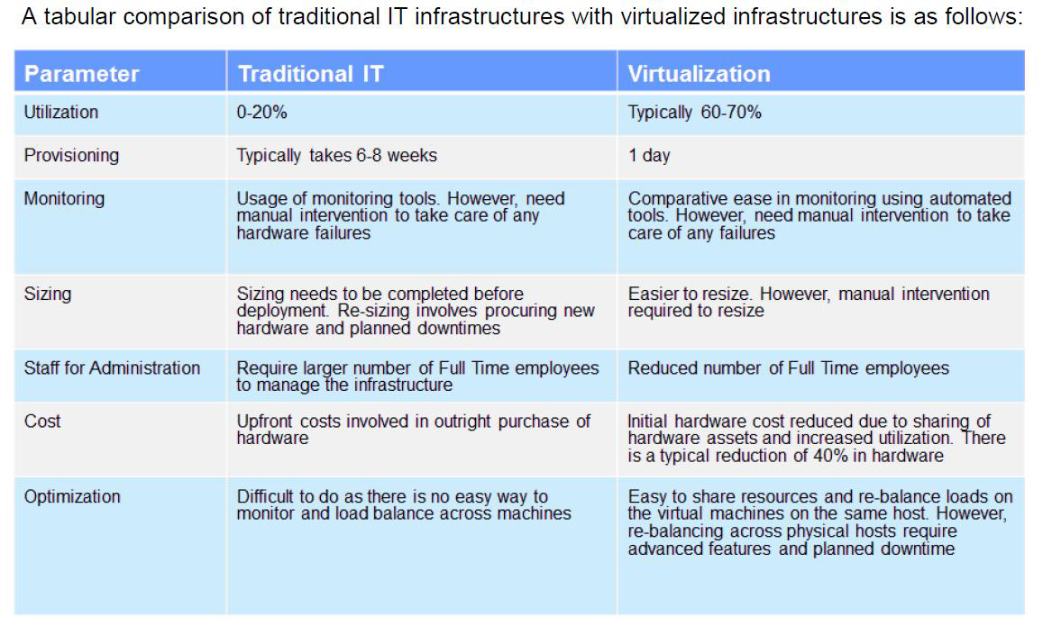
Comparison between traditional infra and virtualization

Slide 17
areas where virtualization is not recommended
Legacy software/systems that are not designed for virtualization
Resource Intensive Applications that make assumptions on specific system characteristics to operate and perform (Proprietary Applications)
Real-Time Applications where the timings are critical. We place these applications as close to the hardware as possible to guarantee turnaround times.

Slide 18
Types of virtualization
Full Virtualization
Emulation
Simulation
Hardware Assisted Virtualization (HAV)
Para Virtualization

Slide 19
Full Virtualization
Refers to a set of techniques to fully simulate the underlying physical server environment.
The simulation is so effective that an operating system designed to run on a physical server can be run unmodified on a fully virtualized virtual machine
The hypervisor traps and effectively translates any machine instructions for IO operations or any other instructions that require direct or privileged access to the underlying physical hardware.

Slide 20
Emulation
Emulation refers to a set of techniques to virtualize a completely distinct hardware than the underlying physical hardware.
Emulation refers to the use of firmware and hardware to emulate an altogether different hardware.
Emulation is used for the purpose of running old legacy applications in their native OS environments while making use of the cutting edge high performance hardware available today.

Slide 21
Simulation
Simulation refers to techniques that create an exact virtual footprint of the underlying hardware for the purposes of virtualization.
The main reason for virtualization-by-simulation is isolation and consolidation of OS and applications.
Reduction of SW licensing costs.
Reduces less number of OS instances that have to be managed
When we refer to Full Virtualization in the industry, we generally refer to simulation. [Very thin line of Difference]

Slide 22
Hardware-Assisted-Virtualization (HAV)
Hardware Assisted Virtualization (HAV) use features provided by the hardware to improve performance of the simulated virtual machines.
The approach uses features provided by the host physical processor to improve efficiency of virtualization thereby improving the performance of the virtual machines.
Examples: Intel VT-x and AMD-V

Slide 23
Paravirtualization
Paravirtualization involves modifying the OS kernel. The OS kernel acts as a bridge between the applications and the processing done at the hardware level.
A hypercall is based on the same concept as a system call. System calls are used by an application to request services from the OS and provide the interface between the application or process and the OS.
Hypercalls work the same way, except the hypervisor is used.

Slide 24
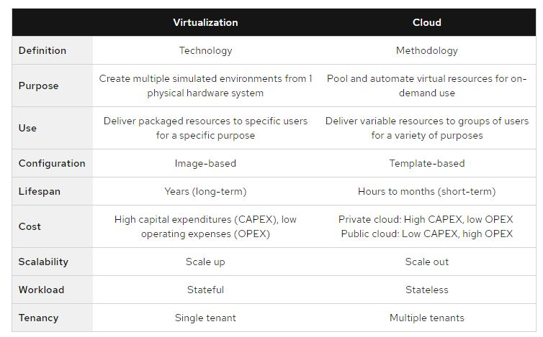
Difference between cloud and virtualization

